Slide 1
CTE (Common Table Expressions)

Slide 2
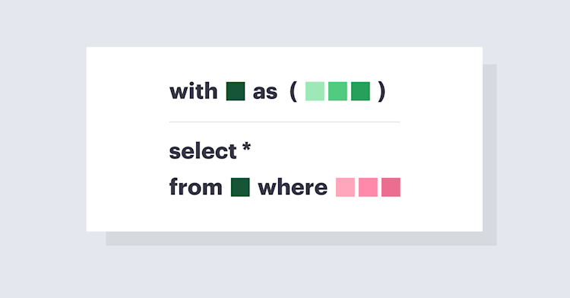
CTE (Common Table Expressions)
A CTE is a temporary named result set in SQL that can be referred to within a SELECT, INSERT, UPDATE, or DELETE statement.
Purpose:
  Simplifies complex queries
  Improves readability
  Can be recursive
Syntax:
WITH cte_name AS (
SELECT column1, column2
FROM table_name
WHERE condition
)
SELECT *
FROM cte_name;
WITH – defines the CTE
cte_name – the name of the temporary table

Slide 3
CTE (Common Table Expressions)
Simple CTE
Sample Table: Employees
EmpID | Name | Department | Salary
1 | Alice | HR | 5000
2 | Bob | IT | 6000
3 | Carol | IT | 7000
Query:
Output:
WITH IT_Employees AS (
SELECT Name, Salary
FROM Employees
WHERE Department = 'IT'
)
SELECT *
FROM IT_Employees;
Name | Salary
Bob | 6000
Carol | 7000

Slide 4
CTE (Common Table Expressions)
Recursive CTE
A recursive CTE is a CTE that refers to itself to process hierarchical or iterative data.
Useful for:
  Organizational hierarchies (employees & managers)
  Bill of materials
  Tree-like data structures
Consists of:
  Anchor member – starting point
  Recursive member – iteratively adds rows
Syntax:
WITH RECURSIVE cte_name AS (
-- Anchor member
SELECT columns
FROM table_name
WHERE condition
UNION ALL
-- Recursive member
SELECT columns
FROM table_name t
INNER JOIN cte_name c ON t.column = c.column
)
SELECT *
FROM cte_name;

Slide 5
CTE (Common Table Expressions)
Sample Table: Employees
EmpID | Name | ManagerID
1 | John | NULL
2 | Mike | 1
3 | Sara | 2
4 | Emma | 1
5 | David | 4
6 | Alice | 5
7 | Robert | 2

Slide 6
CTE (Common Table Expressions)
Query:
WITH RECURSIVE EmployeeHierarchy AS (
-- Anchor member: top-level manager
SELECT EmpID, Name, ManagerID, 1 AS Level
FROM Employees
WHERE ManagerID IS NULL
UNION ALL
-- Recursive member: employees reporting to those in hierarchy
SELECT e.EmpID, e.Name, e.ManagerID, eh.Level + 1
FROM Employees e
INNER JOIN EmployeeHierarchy eh ON e.ManagerID = eh.EmpID
)
SELECT *
FROM EmployeeHierarchy
ORDER BY Level, ManagerID;

Slide 7
CTE (Common Table Expressions)
Output:
EmpID | Name | ManagerID | Level
1 | John | NULL | 1
2 | Mike | 1 | 2
4 | Emma | 1 | 2
3 | Sara | 2 | 3
7 | Robert | 2 | 3
5 | David | 4 | 3
6 | Alice | 5 | 4

Slide 8
CTE (Common Table Expressions)
Advantages of CTEs
Improves query readability
Makes complex queries simpler
Supports recursion
Can be used multiple times in a query
Key Points to Remember
CTE exists only during query execution
Can be recursive or non-recursive
Must be followed by a main query

Slide 9
Temporary Tables

Slide 10
Temporary Tables
Temporary tables are special tables used to store data temporarily during a session. These are automatically dropped when the session ends (or explicitly dropped).These are useful for complex queries, intermediate results, and performance optimization.
Types of Temporary Tables
Local Temporary Table
Name starts with # (e.g., #TempTable)
Visible only to the session that created it.
Dropped automatically when session ends.
Global Temporary Table
Name starts with ## (e.g., ##TempTable).
Visible to all sessions.
Dropped when the last session using it ends.

Slide 11
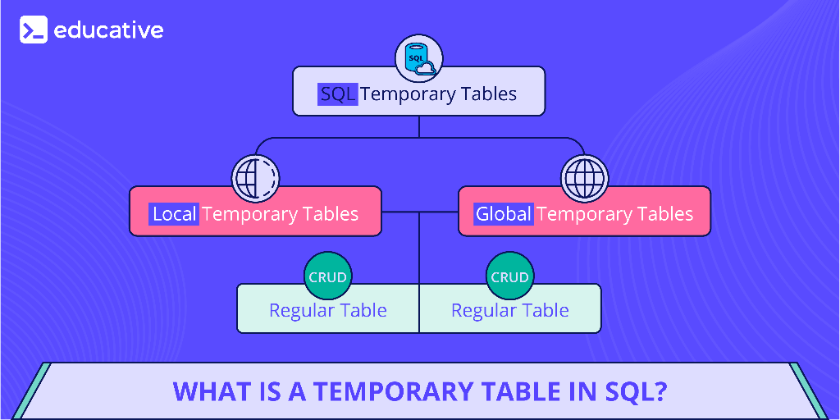
Temporary Tables
Create Local Temporary Table
Syntax:
CREATE TABLE #TempTable (
ID INT,
Name VARCHAR(50)
);
Create Global Temporary Table
Syntax:
CREATE TABLE ##TempTable (
ID INT,
Name VARCHAR(50)
);

Slide 12
Temporary Tables
Key Features
Advantages & Limitations
Exist only in tempdb database.
Auto-deleted after session ends.
Can use indexes, joins, constraints like normal tables.
Faster than permanent tables for temporary data.
Advantages:
Improve query performance.
Reduce code complexity.
Session-specific data handling.
Limitations:
Occupies memory in tempdb.
Not suitable for long-term storage.
Dropped automatically (data not permanent).
Use Cases
Storing intermediate results in complex queries.
Breaking down big queries into smaller parts.
Handling bulk insert/update operations.
Used in stored procedures for temporary data storage.

Slide 13
Temporary Tables
Difference – Permanent vs Temporary Tables
Feature | Permanent Table | Temporary Table
Storage | User-defined DB | tempdb
Lifetime | Until dropped | Until session ends
Accessibility | All users | Session (or global)
Naming Convention | Normal | # or ## prefix
Conclusion
Temporary tables are best for short-term data storage.
Help simplify complex queries.
Widely used in ETL, stored procedures, and reporting.

Slide 14
Pivot and Unpivot

Slide 15
Pivot
Pivot and Unpivot are used to transform data in SQL. It is useful in reporting and analytics.
Pivot: Converts rows into columns.
Unpivot: Converts columns into rows.
PIVOT
The PIVOT operator rotates table data.
Converts unique column values into multiple columns.
Often used to create summary reports.
Syntax:
SELECT <non-pivoted columns>,
[FirstColumn], [SecondColumn], ...
FROM <TableName>
PIVOT (
AGG_FUNCTION(<column_to_aggregate>)
FOR <column_to_convert_into_headers> IN ([FirstColumn], [SecondColumn], ...)
) AS PivotTable;

Slide 16
Pivot
Sample Table: Sales
Year | Product | Amount
2023 | Pen | 100
2023 | Book | 200
2024 | Pen | 150
2024 | Book | 250
Query:
SELECT Year, [Pen], [Book]
FROM Sales
PIVOT (
SUM(Amount)
FOR Product IN ([Pen], [Book])
) AS PivotTable;
Output:
Year | Pen | Book
2023 | 100 | 200
2024 | 150 | 250

Slide 17
Unpivot
UNPIVOT
The UNPIVOT operator rotates columns into rows.
Useful when you need normalized/tabular form.
Opposite of PIVOT.
SELECT <non-unpivoted columns>,
ColumnName, Value
FROM <TableName>
UNPIVOT (
Value FOR ColumnName IN ([Col1], [Col2], [Col3], ...)
) AS UnpivotTable;

Slide 18
Unpivot
Sample Table: Sales
Year | Pen | Book
2023 | 100 | 200
2024 | 150 | 250
Query:
SELECT Year, Product, Amount
FROM SalesUnpivot
UNPIVOT (
Amount FOR Product IN ([Pen], [Book])
) AS UnpivotTable;
Output:
Year | Product | Amount
2023 | Pen | 100
2023 | Book | 200
2024 | Pen | 150
2024 | Book | 250

Slide 19
Pivot vs Unpivot
Feature | PIVOT (Rows → Columns) | UNPIVOT (Columns → Rows)
Definition | Converts rows into columns | Converts columns into rows
Purpose | To summarize and create cross-tab reports | To normalize denormalized data
Transformation | Horizontal (row values become column headers) | Vertical (column headers become row values)
Use Case | Reporting, dashboards, aggregated summaries | Data cleaning, ETL, preparing normalized tables
Example Input | Year, Product, Amount | Year, Pen, Book
Example Output | Year, [Pen], [Book] | Year, Product, Amount
Best For | Displaying summarized data in wide format | Converting wide data back to tall/long format

Slide 20
JSON and XML in SQL

Slide 21
JSON and XML in SQL
Modern databases often need to handle semi-structured data.
JSON (JavaScript Object Notation) and XML (Extensible Markup Language) are widely used formats.
SQL Server and other RDBMSs provide built-in support for JSON and XML.
JSON in SQL
JSON stores data in key-value pairs.
Easy to read and lightweight.
Widely used in APIs, web apps, and data exchange.
Common JSON Functions
OPENJSON() – Parses JSON into rows/columns.
FOR JSON – Converts SQL query results into JSON.
JSON_VALUE() – Extracts a single value.
JSON_QUERY() – Extracts an object/array.
ISJSON() – Checks if data is valid JSON.

Slide 22
JSON and XML in SQL
Example
JSON Data:
{
"ID": 1,
"Name": “Ananya",
"City": "Ambala"
}
SQL Query:
SELECT *
FROM OPENJSON('{"ID":1,"Name":“Ananya","City":"Ambala"}')
WITH (
ID INT,
Name NVARCHAR(50),
City NVARCHAR(50)
);
Output:
ID | Name | City
1 | Ananya | Ambala

Slide 23
JSON and XML in SQL
XML in SQL
XML stores data in tags and hierarchy.
Suitable for structured documents.
Used in data transfer, configuration, legacy systems.
Common XML Functions
FOR XML – Converts SQL query results into XML.
nodes() – Shreds XML into rows.
value() – Extracts single values.
query() – Extracts XML fragments.
exist() – Checks if a node exists.

Slide 24
JSON and XML in SQL
Example
XML Data:
<Employee>
<ID>1</ID>
<Name>Ananya</Name>
<City>Ambala</City>
</Employee>
SQL Query:
DECLARE @xml XML =
'<Employee><ID>1</ID><Name>Ananya</Name><City>Ambala</City></Employee>';
SELECT
@xml.value('(/Employee/ID)[1]', 'INT') AS ID,
@xml.value('(/Employee/Name)[1]', 'NVARCHAR(50)') AS Name,
@xml.value('(/Employee/City)[1]', 'NVARCHAR(50)') AS City;
Output:
ID | Name | City
1 | Ananya | Ambala

Slide 25
JSON and XML in SQL
Feature | JSON | XML
Data Format | Key-value pairs | Tag-based hierarchical structure
Readability | Lightweight, easy to read | Verbose, harder to read
Usage | Modern APIs, web, NoSQL | Legacy systems, configs, SOAP
Storage in SQL | NVARCHAR (text format) | XML data type
Functions | OPENJSON, JSON_VALUE, etc. | nodes(), value(), query(), etc.
Conclusion:
Both JSON and XML are essential for semi-structured data handling in SQL.
JSON → preferred for modern APIs and lightweight storage.
XML → useful for structured documents and legacy systems.
SQL provides strong support for both with built-in functions.

Slide 26
Data Transformations in SQL

Slide 27
Data Transformations in SQL
It is the process of converting data from one format/structure into another. It helps in cleaning, organizing, and making data useful. Examples: Changing data types, Combining or splitting columns, Aggregating data.
Why are Data Transformations Important?
Ensures data consistency
Improves data quality
Prepares data for analytics & reporting
Used in ETL (Extract, Transform, Load) process
Types of Data Transformations in SQL
Data Cleaning – removing duplicates, handling NULLs
Data Aggregation – SUM, AVG, COUNT, MIN, MAX
Data Filtering – WHERE, HAVING
Data Joining – JOINs to combine tables
Data Restructuring – PIVOT & UNPIVOT
Data Conversion – CAST, CONVERT

Slide 28
Data Transformations in SQL
Data Cleaning Example
Data Aggregation Example
SELECT DISTINCT customer_id, UPPER(customer_name)
FROM Customers
WHERE email IS NOT NULL;
SELECT DISTINCT customer_id, UPPER(customer_name)
FROM Customers
WHERE email IS NOT NULL;
Removes duplicates
Converts names to uppercase
Excludes rows with missing emails
Groups by region
Calculates total sales per region
Data Joining Example
Data Restructuring Example
SELECT c.customer_name, o.order_id, o.order_date
FROM Customers c
JOIN Orders o ON c.customer_id = o.customer_id;
SELECT product,
SUM(CASE WHEN year=2023 THEN sales END) AS Sales_2023,
SUM(CASE WHEN year=2024 THEN sales END) AS Sales_2024
FROM Sales
GROUP BY product;
Combines customers and orders details.
Reshapes rows into columns

Slide 29
Data Transformations in SQL
Why Data Transformation is Needed?
Part of ETL Process:
Extract: Data is collected from multiple sources
Transform: Data is cleaned, reshaped, and standardized
Load: Data is stored in a warehouse or database
Levels of Transformation:
Syntactic – Changing format (e.g., date format, data type)
Semantic – Ensuring meaning (e.g., standardizing country names: “USA” → “United States”)
Structural – Changing shape of data (e.g., pivoting rows into columns)
End Goal: To make raw data reliable, consistent, and analysis-ready.
Summary
Data Transformation = Cleaning + Aggregating + Restructuring + Converting
SQL provides multiple functions and clauses for this
Core step in ETL and Data Warehousing

